Slide 1

Time series data analysis and forecast methods
Lecture 2
Principal characteristics of time series data

Slide 2

Lecture map
Theoretical definitions of statistical characteristics
Transition from ensemble averaging to time averaging
Characteristics estimation based on one sample data
Common definition of correlation moments
Autocorrelation function estimation
Correlograms or correlation tables

Slide 3
PART 1. numerical characteristics OF TIME SERIES

Slide 4
Statistical characteristics
For a stationary time series:
Expectation value (average of distribution) and Variance (dispersion) are time-independent;
From them you can estimate any ordinary moments and central moments;
Time series – array of data, generated by stochastic process with one-dimensional probability density function.

Slide 5
Ordinary moment
Expectation value – Midpoint of stochastic data

Slide 6
Central moment
Variance – value of Dispersion

Slide 7
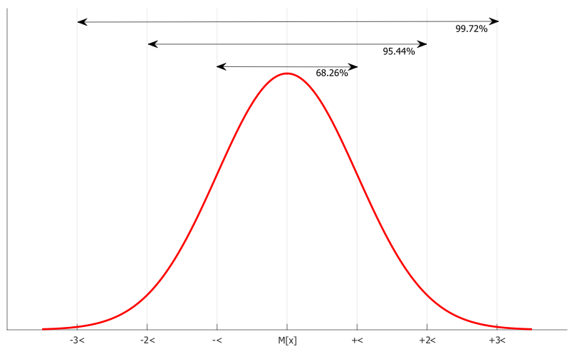

Slide 8
Ergodic process
Transition from ensemble averaging to time averaging;
for time series – also observation averaging;

Slide 9
Expectation (midpoint) value
Variance (dispersion)

Slide 10
PART 2. correlation CHARACTERISTICS OF TIME SERIES

Slide 11
Correlation characteristics
Relation between two stochastic values
Covariance (not centralized)
Correlation (centralized)
Relation between values of one and the same stochastic variable
Autocovariance
Autocorrelation

Slide 12
Covariance
Correlation

Slide 13
Autocovariance
Autocorrelation

Slide 14
Autocorrelation function estimation
Useful features of ACF:
1) Symmetry
2) In point l = 0:
3) Maximum on zero:
4) For random time series:

Slide 15
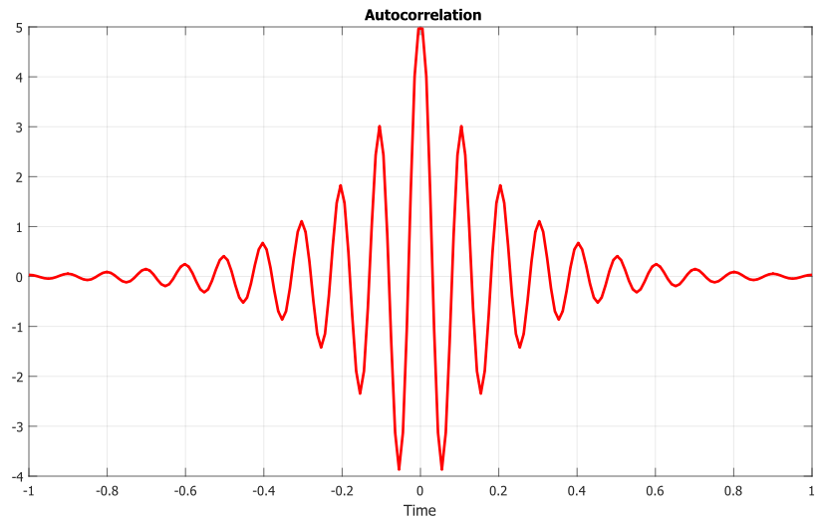

Slide 16
Coefficient of Autocorrelation
Useful features:
1) Symmetry:
2) In point l = 0:
3) Normalized:
4) For random time series:

Slide 17
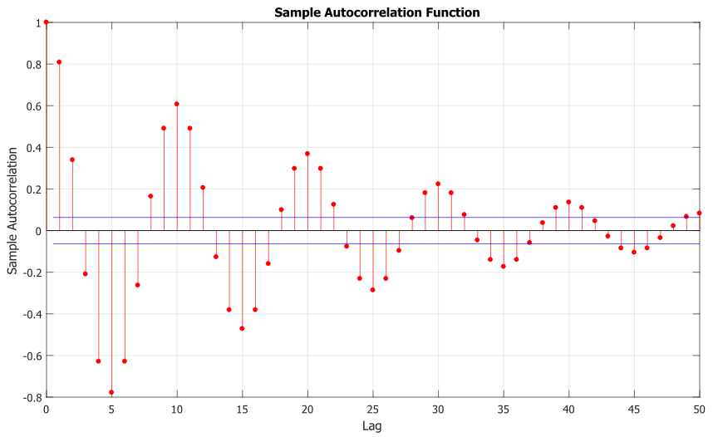

Slide 18
Estimation of sample autocorrelation coefficient

Slide 19
PART 3. AUTOCORRELATION FUNCTION ANALYSIS

Slide 20
ACF
With lag increase for a stationary time series ACF should decrease to zero;
Based on the ACF coefficients estimations we can estimate parameters of ARIMA models;
Note, that there is no link between ACF coefficient sign and trend/tendency increment/decrement nature;

Slide 21
Example
1-7 | 8-14 | 15-21 | 22-28 | 29-35 | 36-42 | 43-49 | 50-56 | 57-63 | 64-70
47 | 41 | 58 | 57 | 25 | 58 | 45 | 52 | 34 | 60
64 | 59 | 44 | 50 | 59 | 45 | 57 | 38 | 35 | 39
23 | 48 | 80 | 60 | 50 | 54 | 50 | 59 | 54 | 59
71 | 71 | 55 | 45 | 71 | 36 | 62 | 55 | 45 | 40
38 | 35 | 37 | 57 | 56 | 54 | 44 | 41 | 65 | 57
64 | 57 | 74 | 50 | 74 | 48 | 64 | 53 | 38 | 54
55 | 40 | 51 | 45 | 50 | 55 | 43 | 49 | 50 | 23

Slide 22
Example

Slide 23
Example

Slide 24
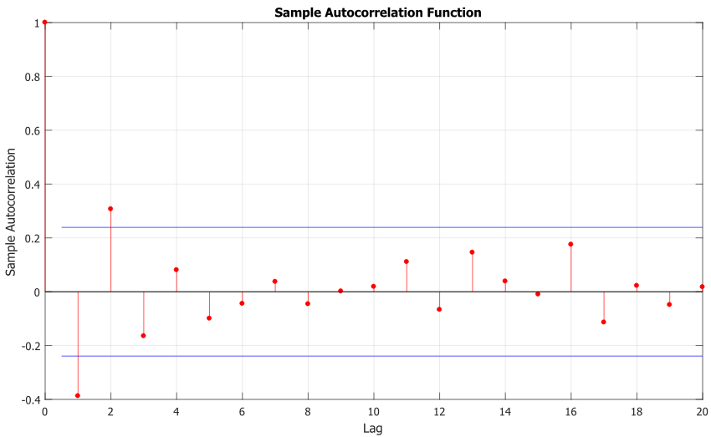

Slide 25
Example
Alternating-sign or oscillating time series corresponds to alternating-sign or oscillating ACF;
A semi-stationary time series due to ACF approaching zero with increasing lag l;
ρ(1) is the biggest point – there is a high correlation between successive points;
ρ(2) is the second biggest point – there is a high chance of autoregressive regularity;
Exponential decrease in oscillating ACF function corresponds to AR model with negative coefficient

Slide 26
References
David R. Brillinger. Time Series: Data Analysis and Theory. — SIAM. — 2001. — 540 p.
Box G., Jenkins G. Time Series Analysis: Forecasting and Control. — 4th ed. Wiley. — 2008. — 784 p.
George A Duckett. Time Series Analysis: Questions and Answers. — CreateSpace Independent Publishing Platform. — 2016. — 258 p. ISBN 978-1-533-57098-7.

